Slide 1

Group-C
Srinivas Manjunath
Suresh Srinivas
Veera Bugide
Ramappagari Kumar
React Project-Auto-Mobile Application

Slide 2
Table of Contents
1.1 Introduction
1.2 Module on Car Accessories Store Application
1.3 Other Highlight
1.4 Benefit of Car Accessories Store Application
1.5 Problem Handling
1.6 Screen Shots

Slide 3
1.1 Introduction
Online Car Accessories store through app has become very popular these days because people find it convenient and easy to shop from their home or office. People can save their time and energy by purchasing products online with some discounts. The offers on the internet can be easily compared, and the buyer can buy the product according to their favourable conditions like price, quality and other discounts for their individual needs. We have most of the companies making use of this trend of getting their company products available on their website for sale, to be accessed via the app. They are also coming out with some great offers to attract customers to download and use their apps more rather than accessing their website.

Slide 4
1.2 Module on Car Accessories Store Application
Customer Module:
Sign Up
Login
Products Page
Product Details Page
Cart Page
Billing & Payment Page
User Profile Page
Admin Module:
Login
Adding Product
Updating or Deleting of Products
Order list Page
User Details Page

Slide 5
1.3 Other Highlight
The Objective of the project “Car Accessories Store” is to develop an online mobile shopping system for selling of Car Accessories.
The Major of this Project is as follow:
Card Payment Verification, Where the verification of the Card Payment is done.
Helping the customer in searching their specific Car Accessories with user friendly search tool.
Provide facility to the customer for online shopping.
Provide a user-friendly user interface for the customer for online search of Accessories.
Provide limited and secured environment for the data access wherever required.

Slide 6
1.4 Benefit of Car Accessories Store Application
Enhanced Performance
Simplicity
Easy Manageability
Customized and Extensibility
Security

Slide 7
1.5 Problem Handling
There are a lot of websites on internet whereby it offers a variety of product and services for consumer can find and buy through online such as shoe, apparel, sun glasses and more Moreover, the online also provides some of the services which is paying bill online, booking a transport ticket and more. In this research, we are looking the problem addressed in this research which is the view of online shopping by consumer. In addition, in this study also understand the influences of the social factors toward to purchase intention of consumers in online shopping and also study the attitude of the consumers purchase intention in online shopping.

Slide 8
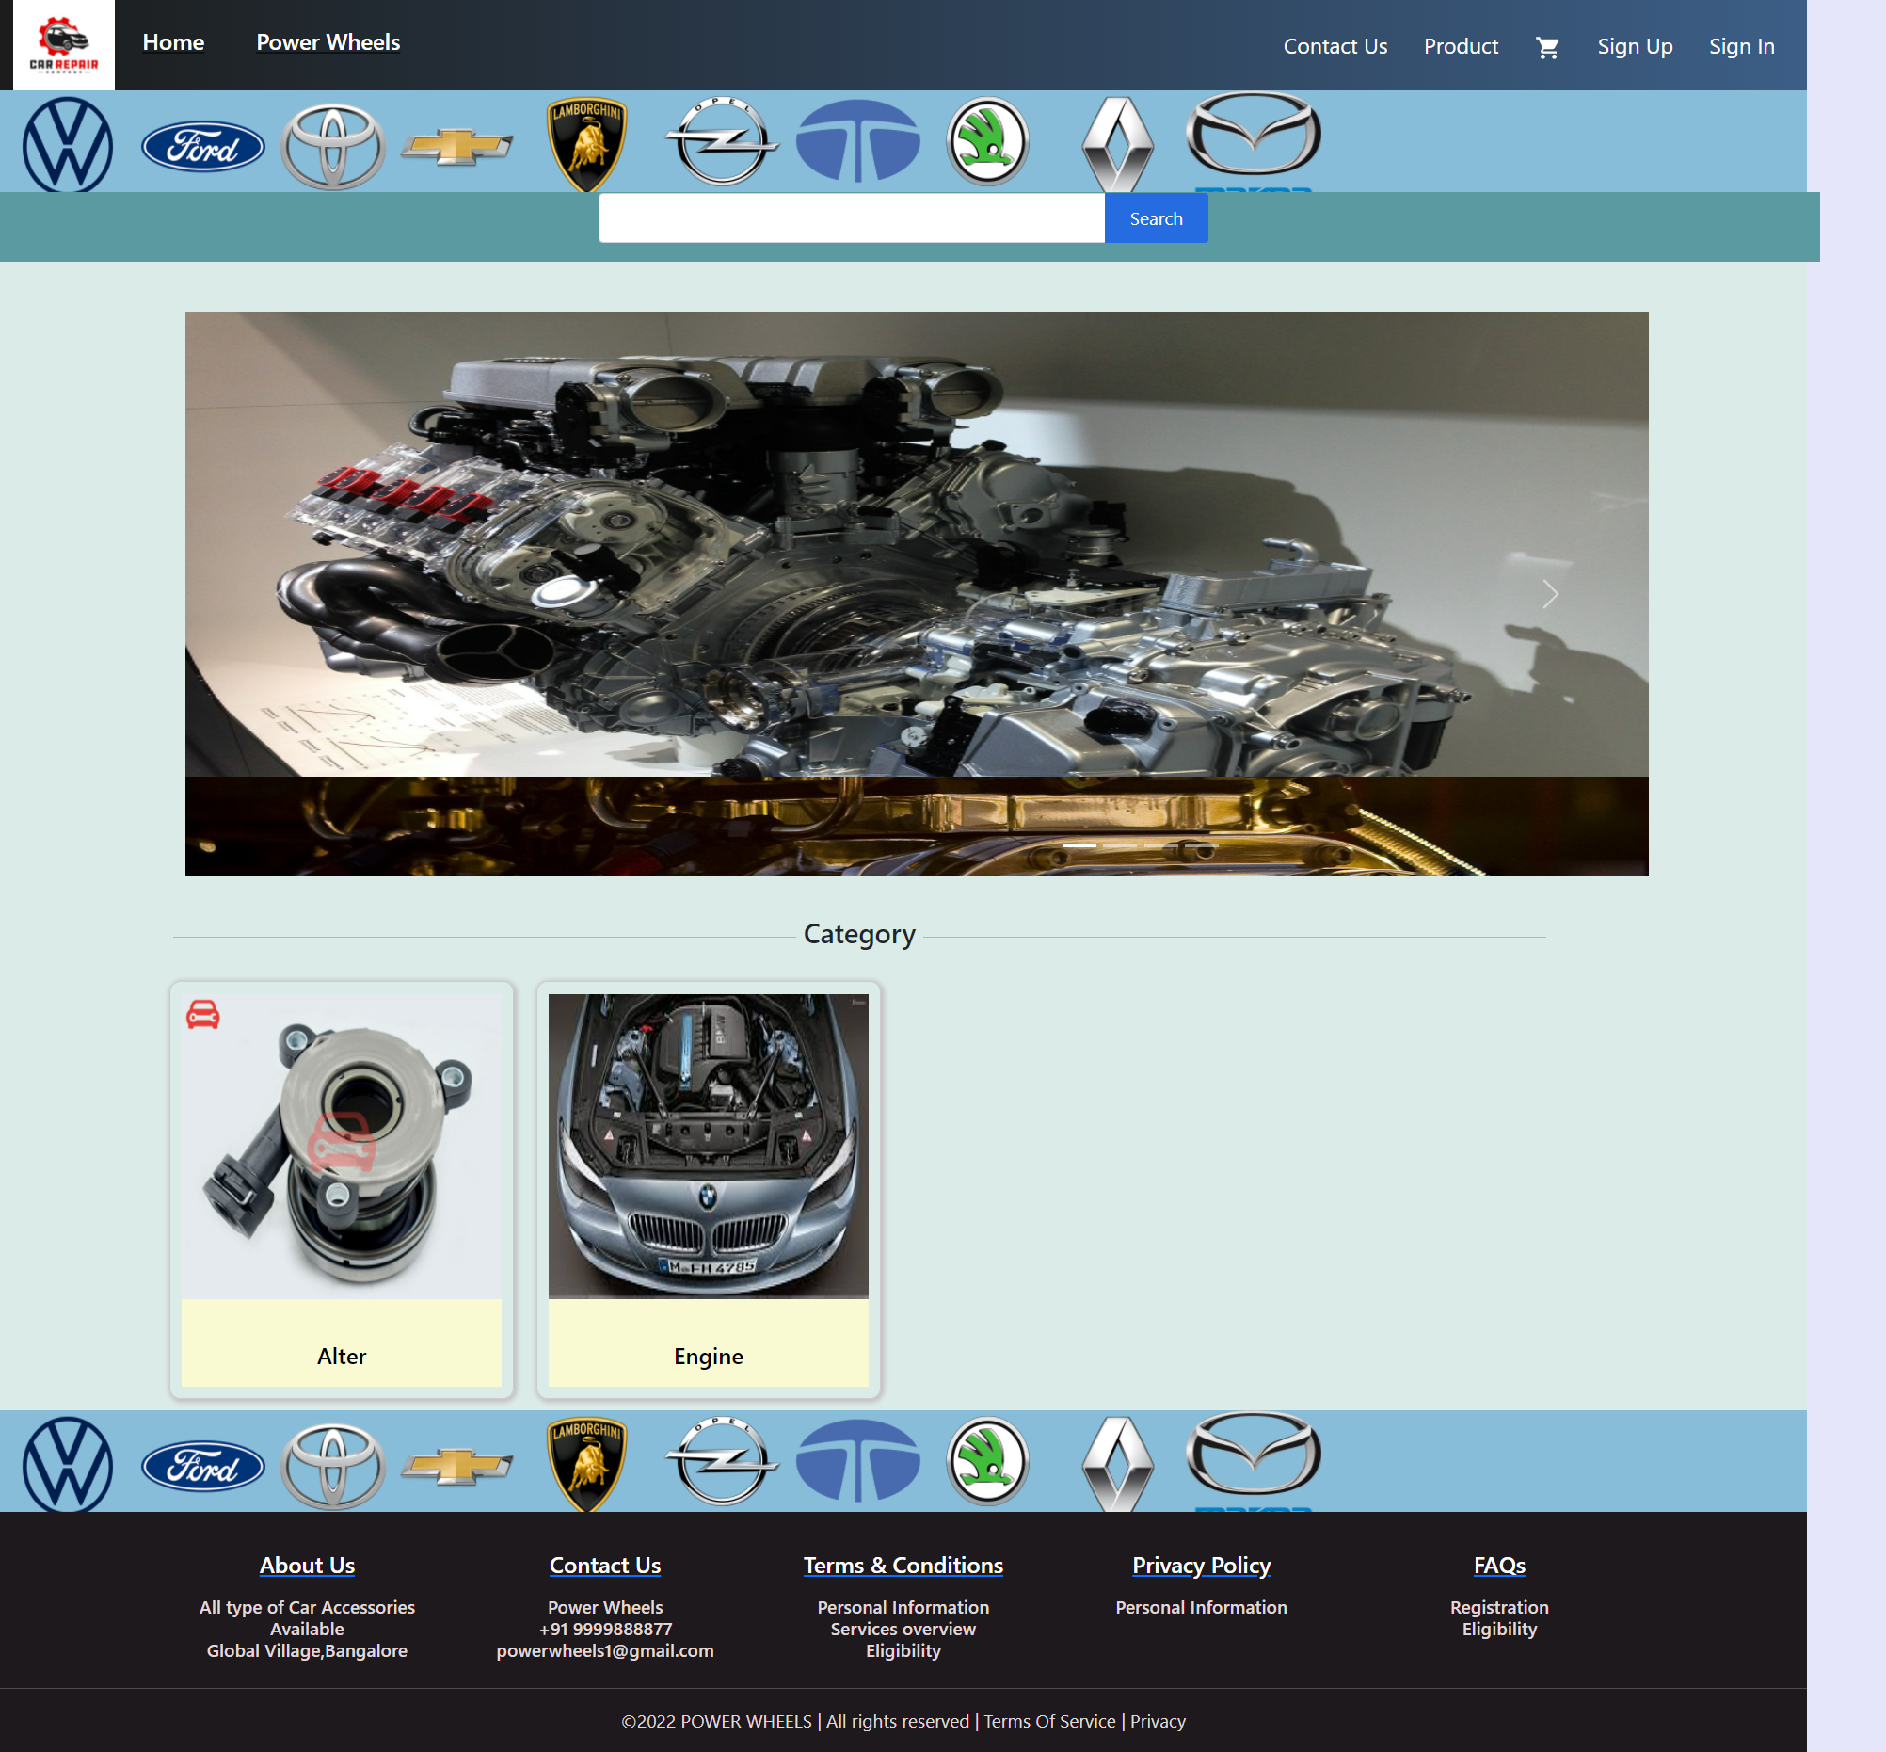
1.6 Screen Shots
Home Page

Slide 9
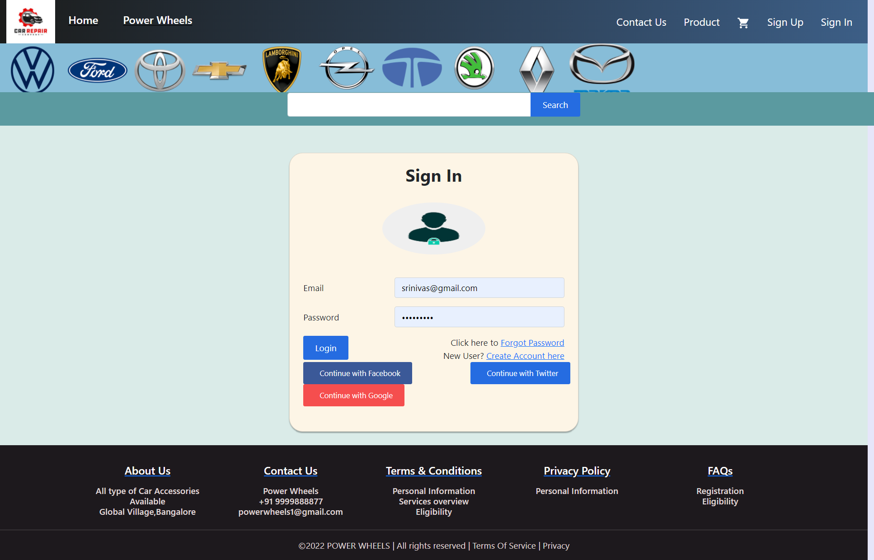
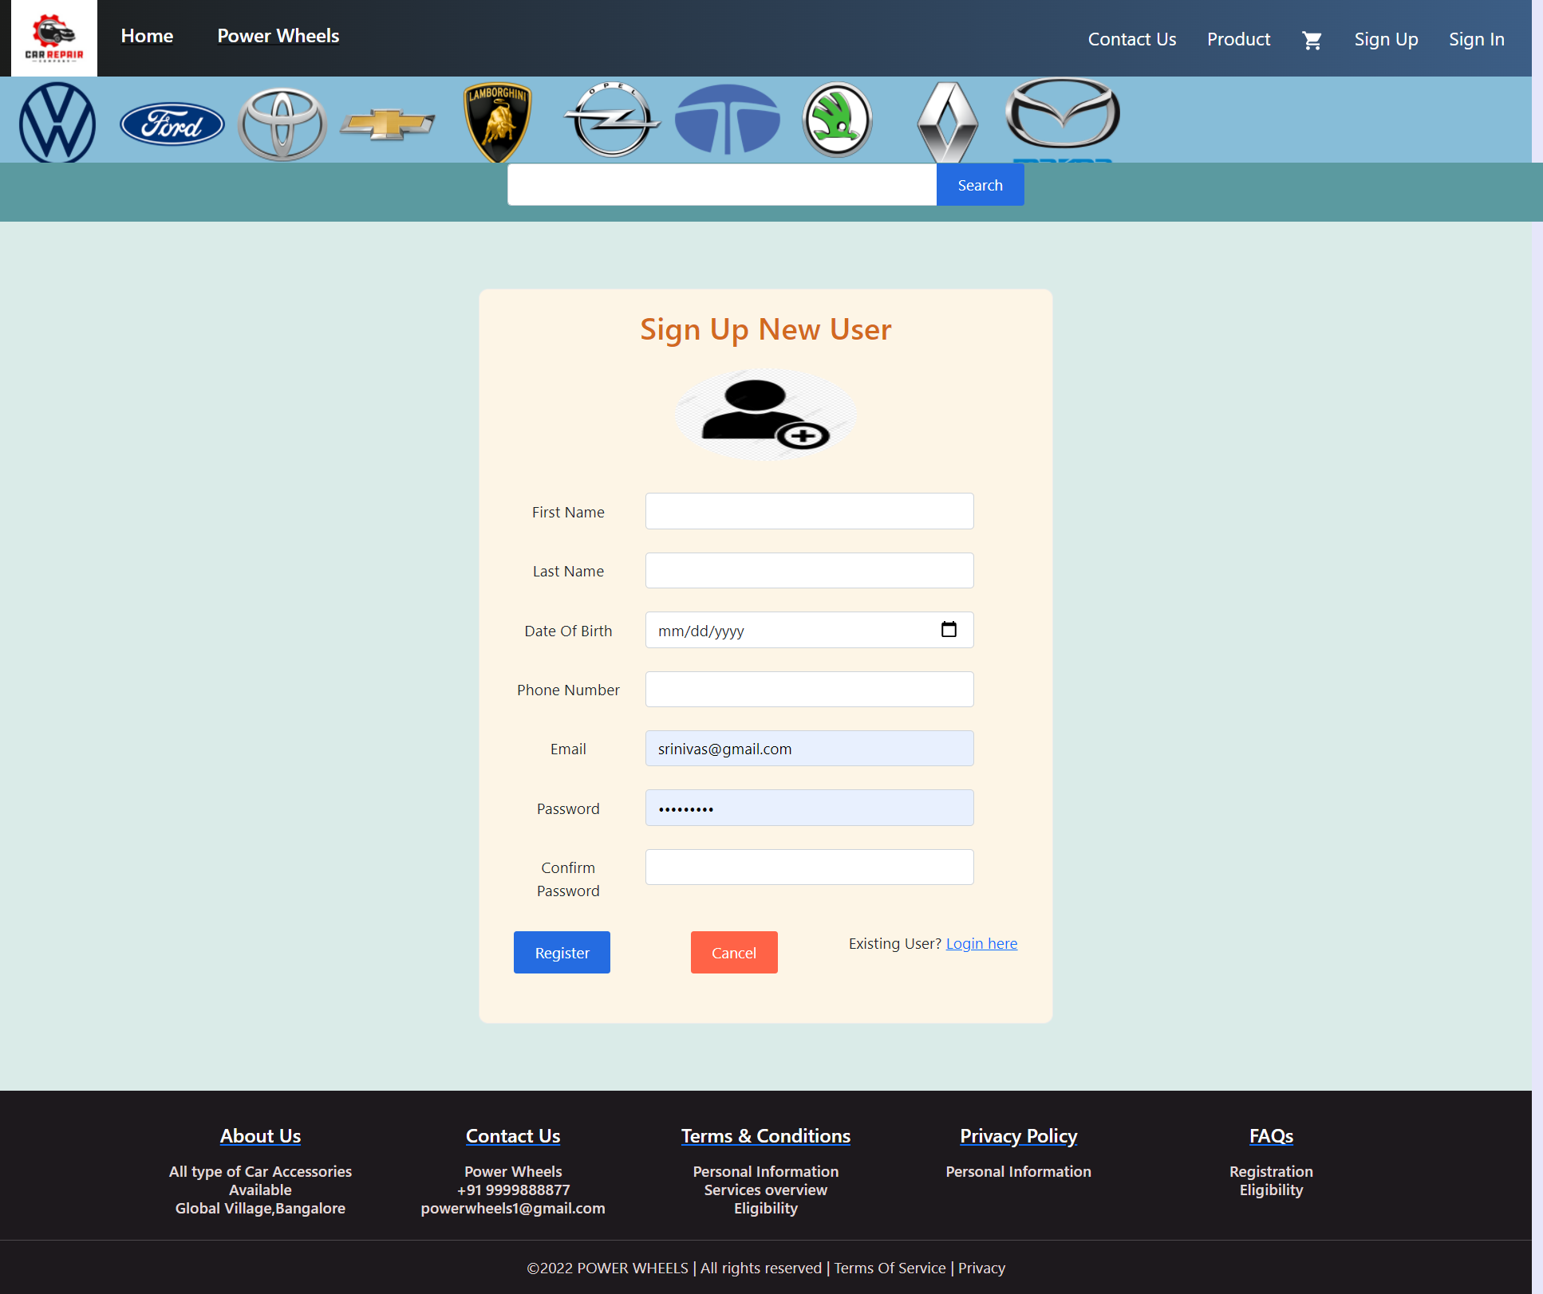
Login and Register Page

Slide 10
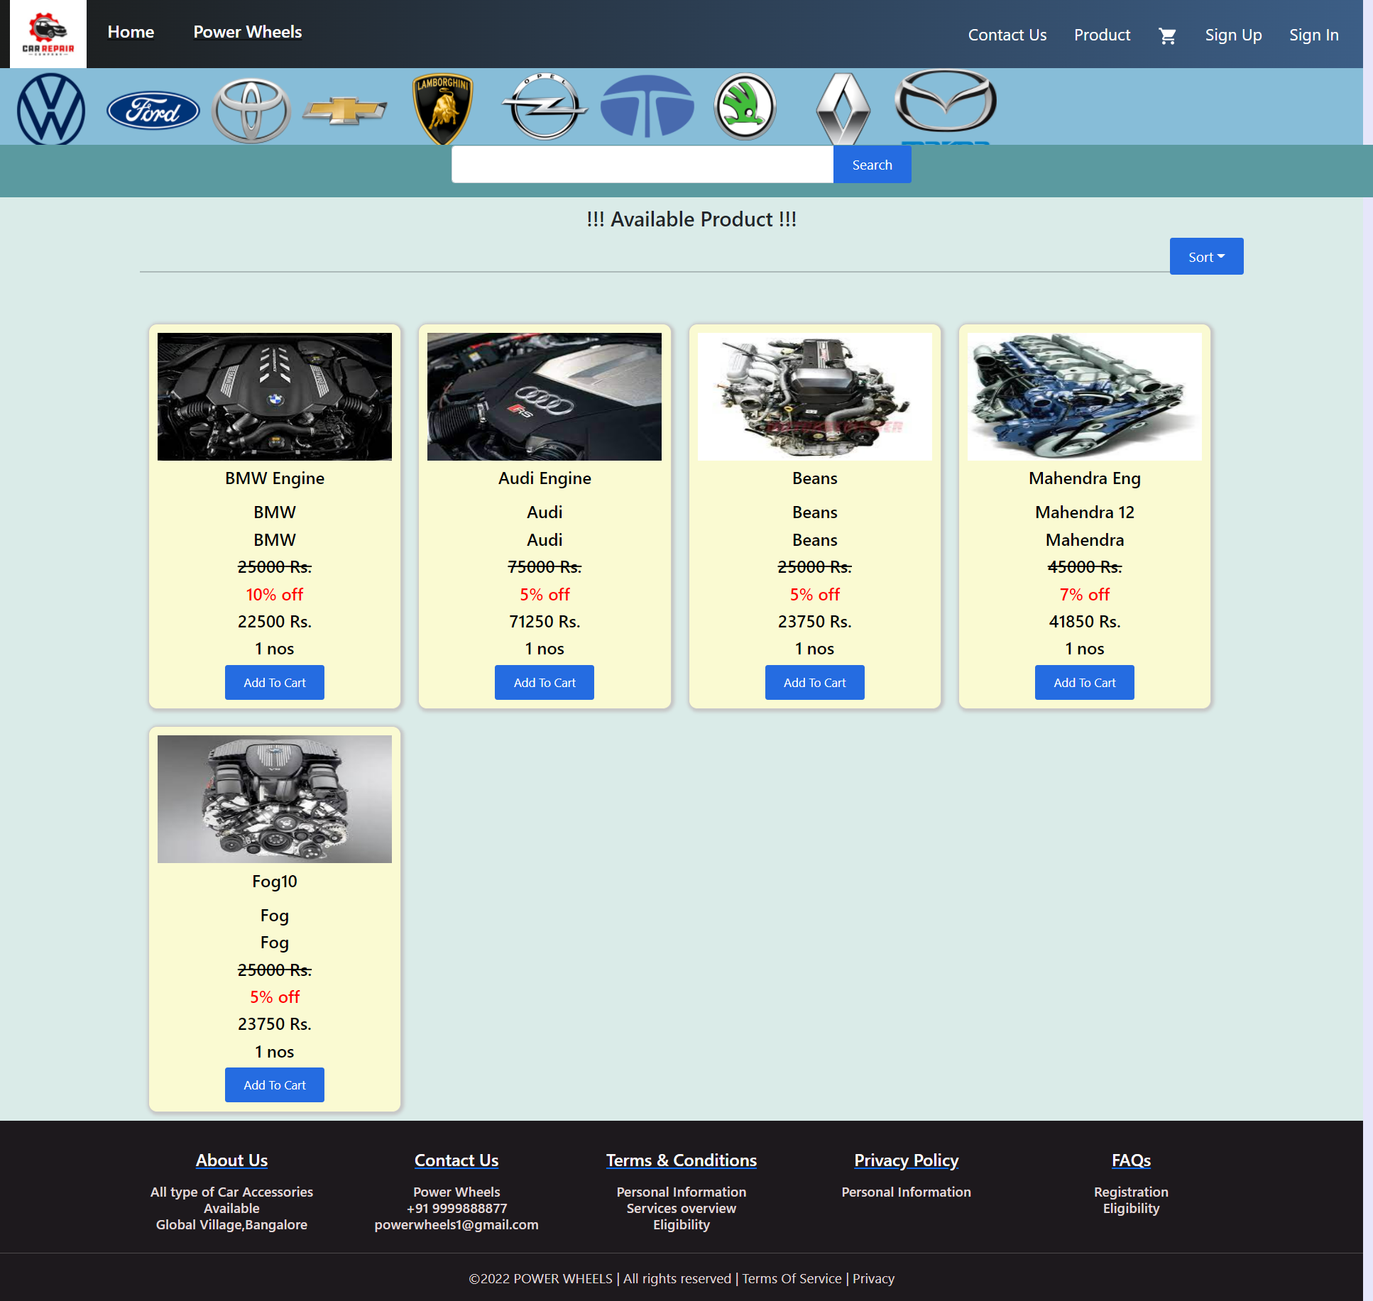
Product Page

Slide 11
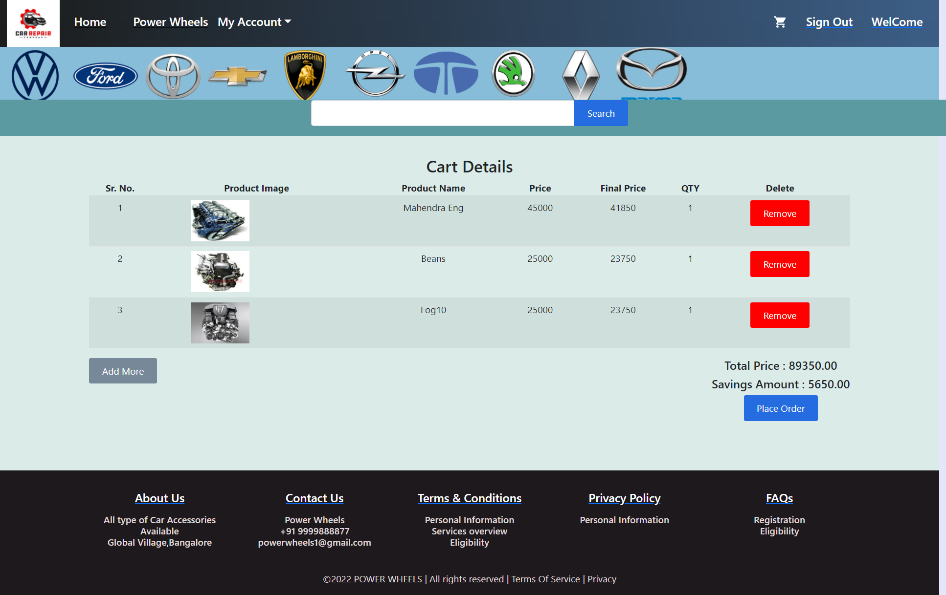
Cart Page

Slide 12
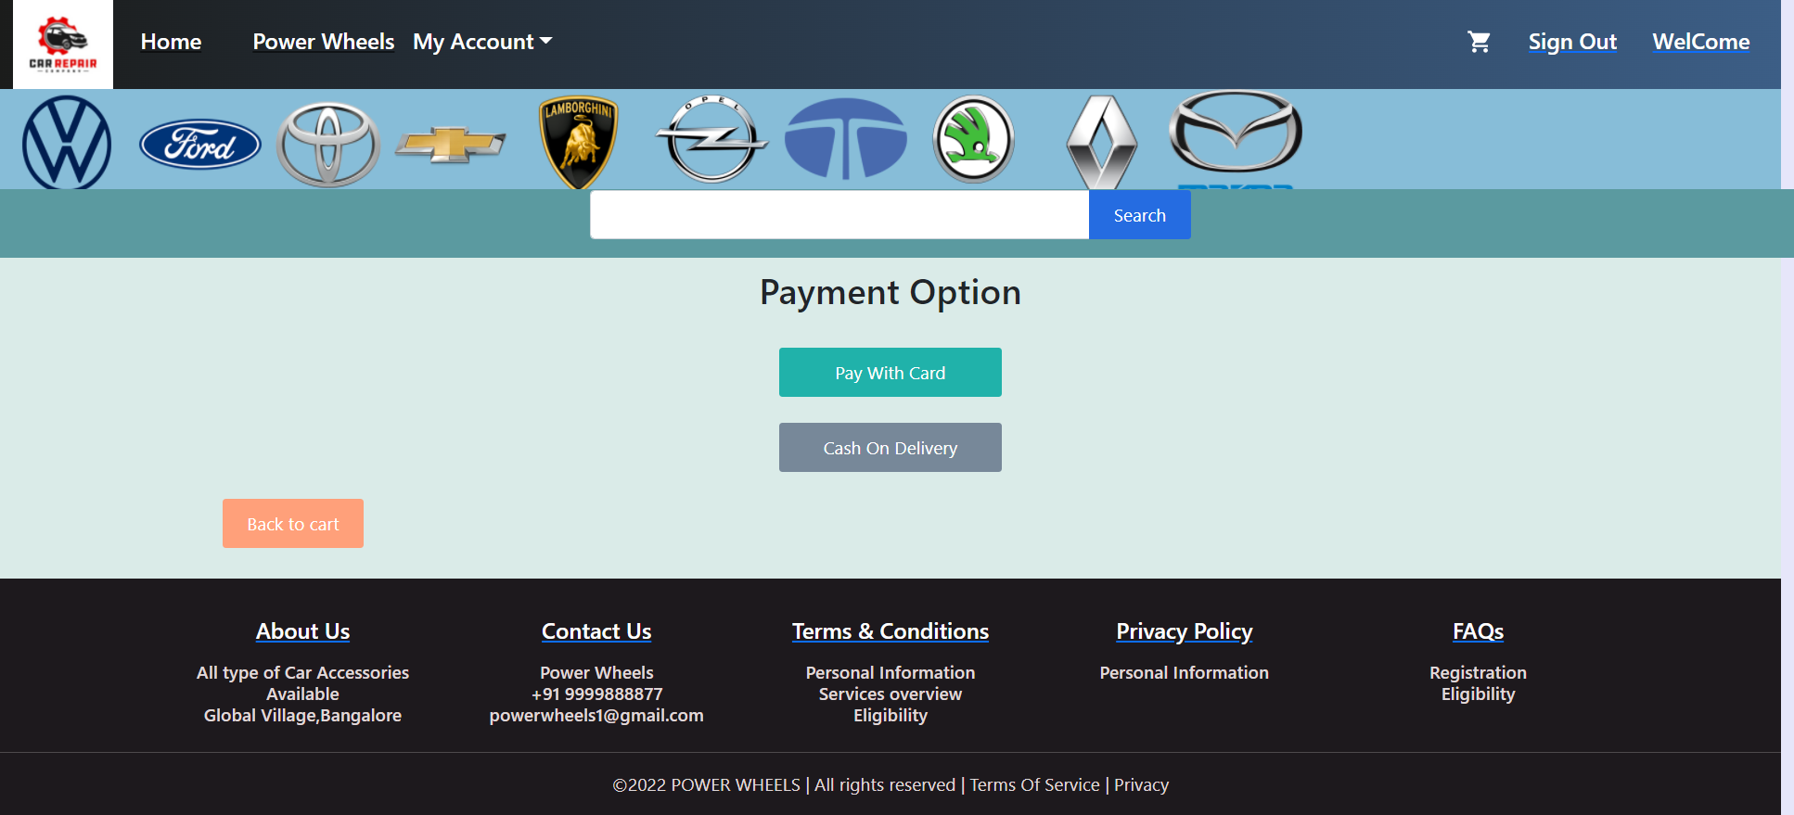
Payment Page

Slide 13
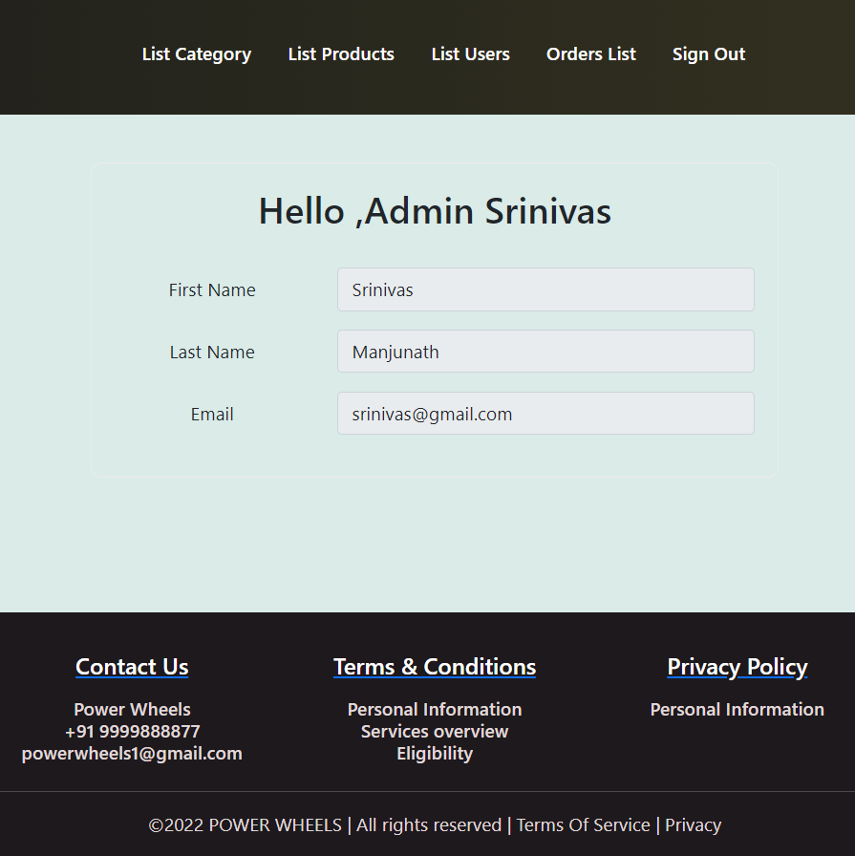
Admin Page

Slide 14
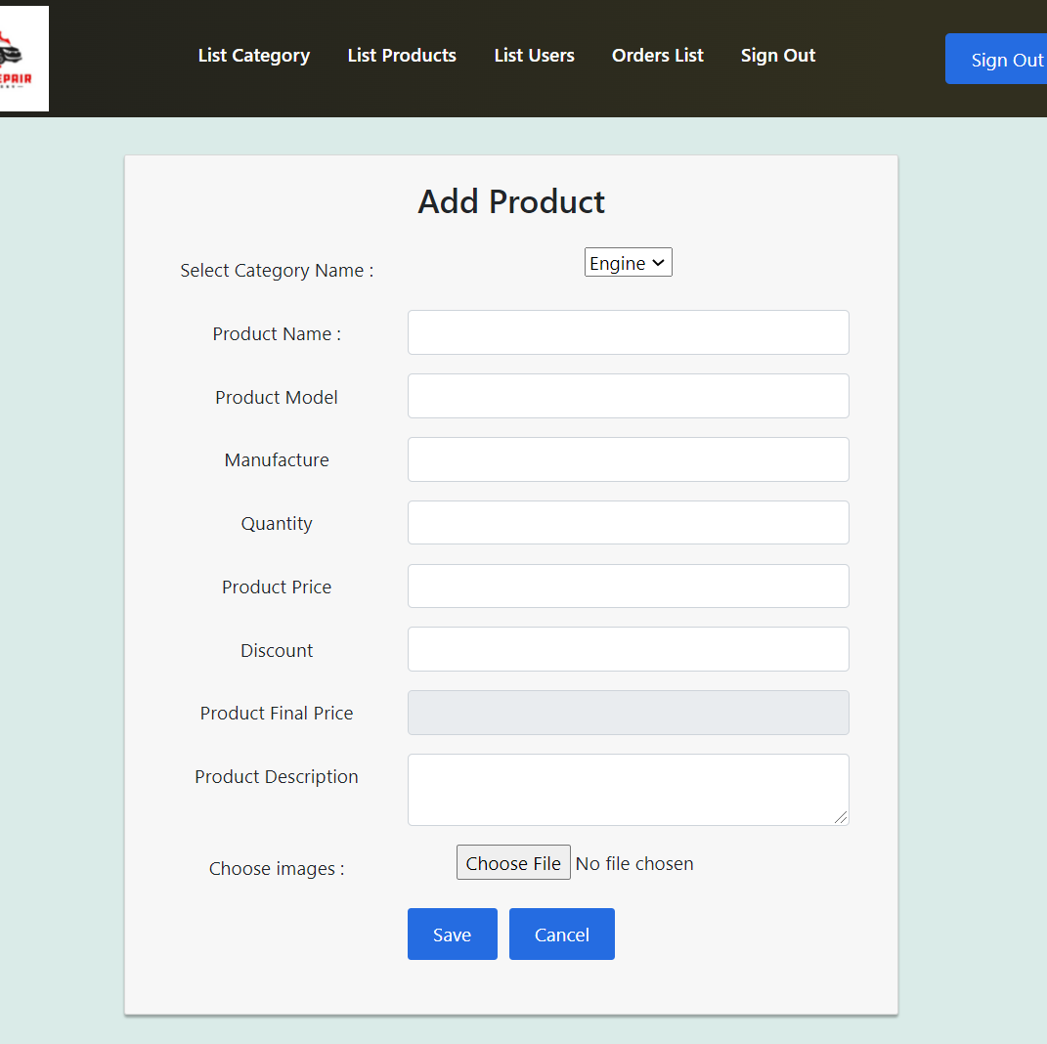
Add Product

Slide 15
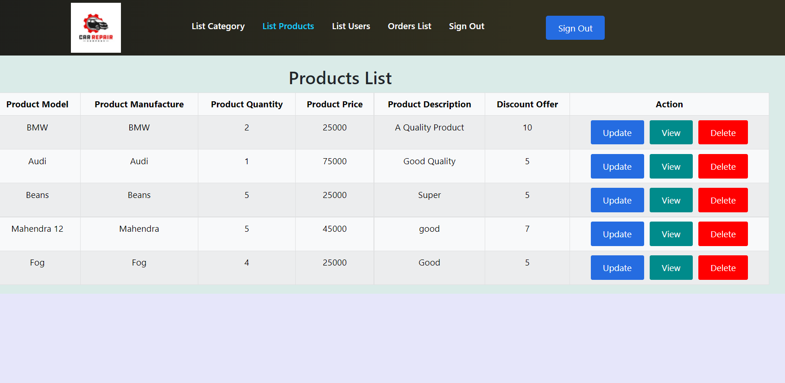
Update Or View Or Delete Products

Slide 16
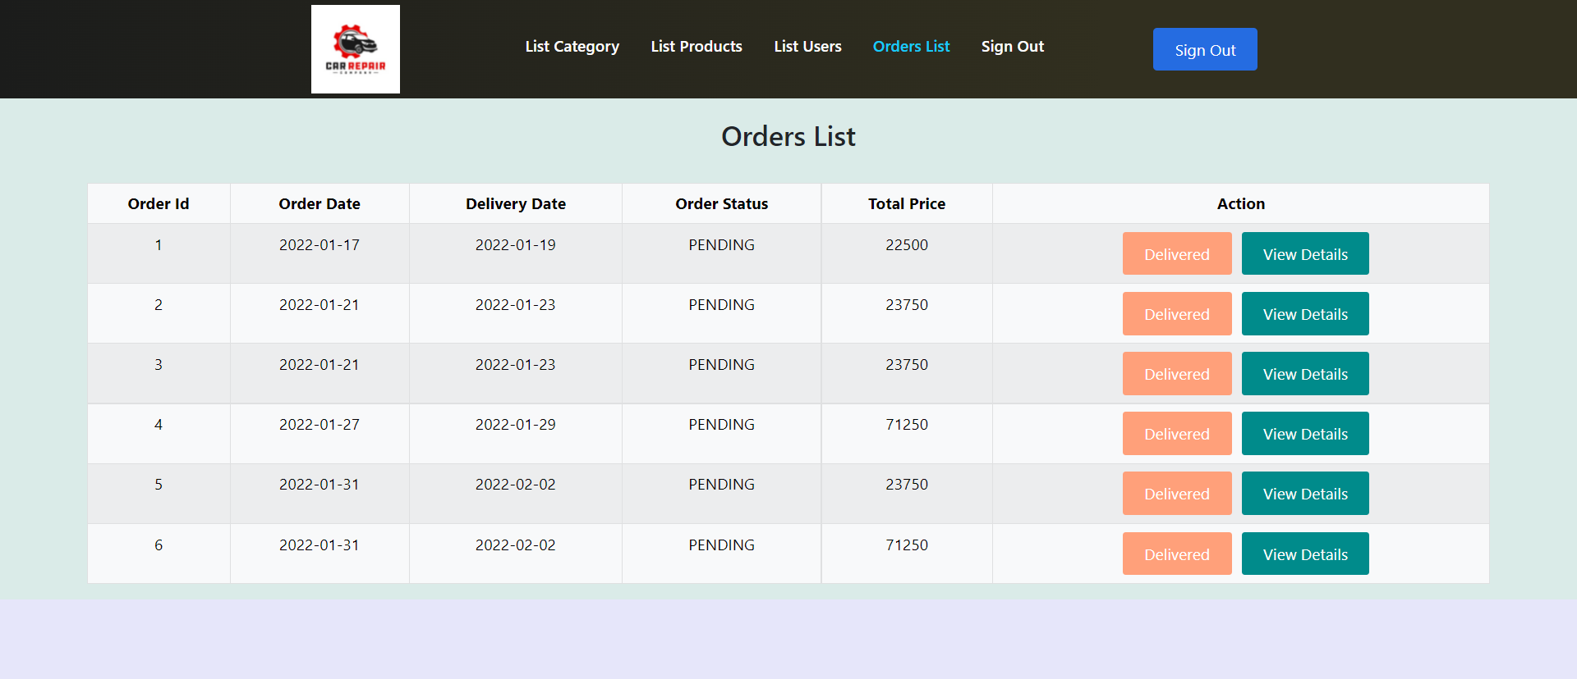
Order List Page

Slide 17
THANK YOU

